Slide 1
HR Workforce Analytics
Strategic Insights & Data Dashboard
Prepared by: Kesha Soni

Slide 2

UNDERSTANDING OUR DATA
This analysis is based on our central employee database, which tracks the professional journey of every individual within our organization.
The dataset captures critical variables including job functions, department assignments, geographic office locations, and demographic identity markers.
By studying this information, we derive a comprehensive picture of our current workforce structure and evolution, enabling data-driven decisions for future hiring and talent management.

Slide 3






STRATEGIC KPIs
Active Headcount
Regional Presence
Retention Stability
Total volume of active employees driving the organization forward today.
The geographic spread of our talent across different global office hubs.
Consistent growth of tenure and loyalty within our core departments.

Slide 4
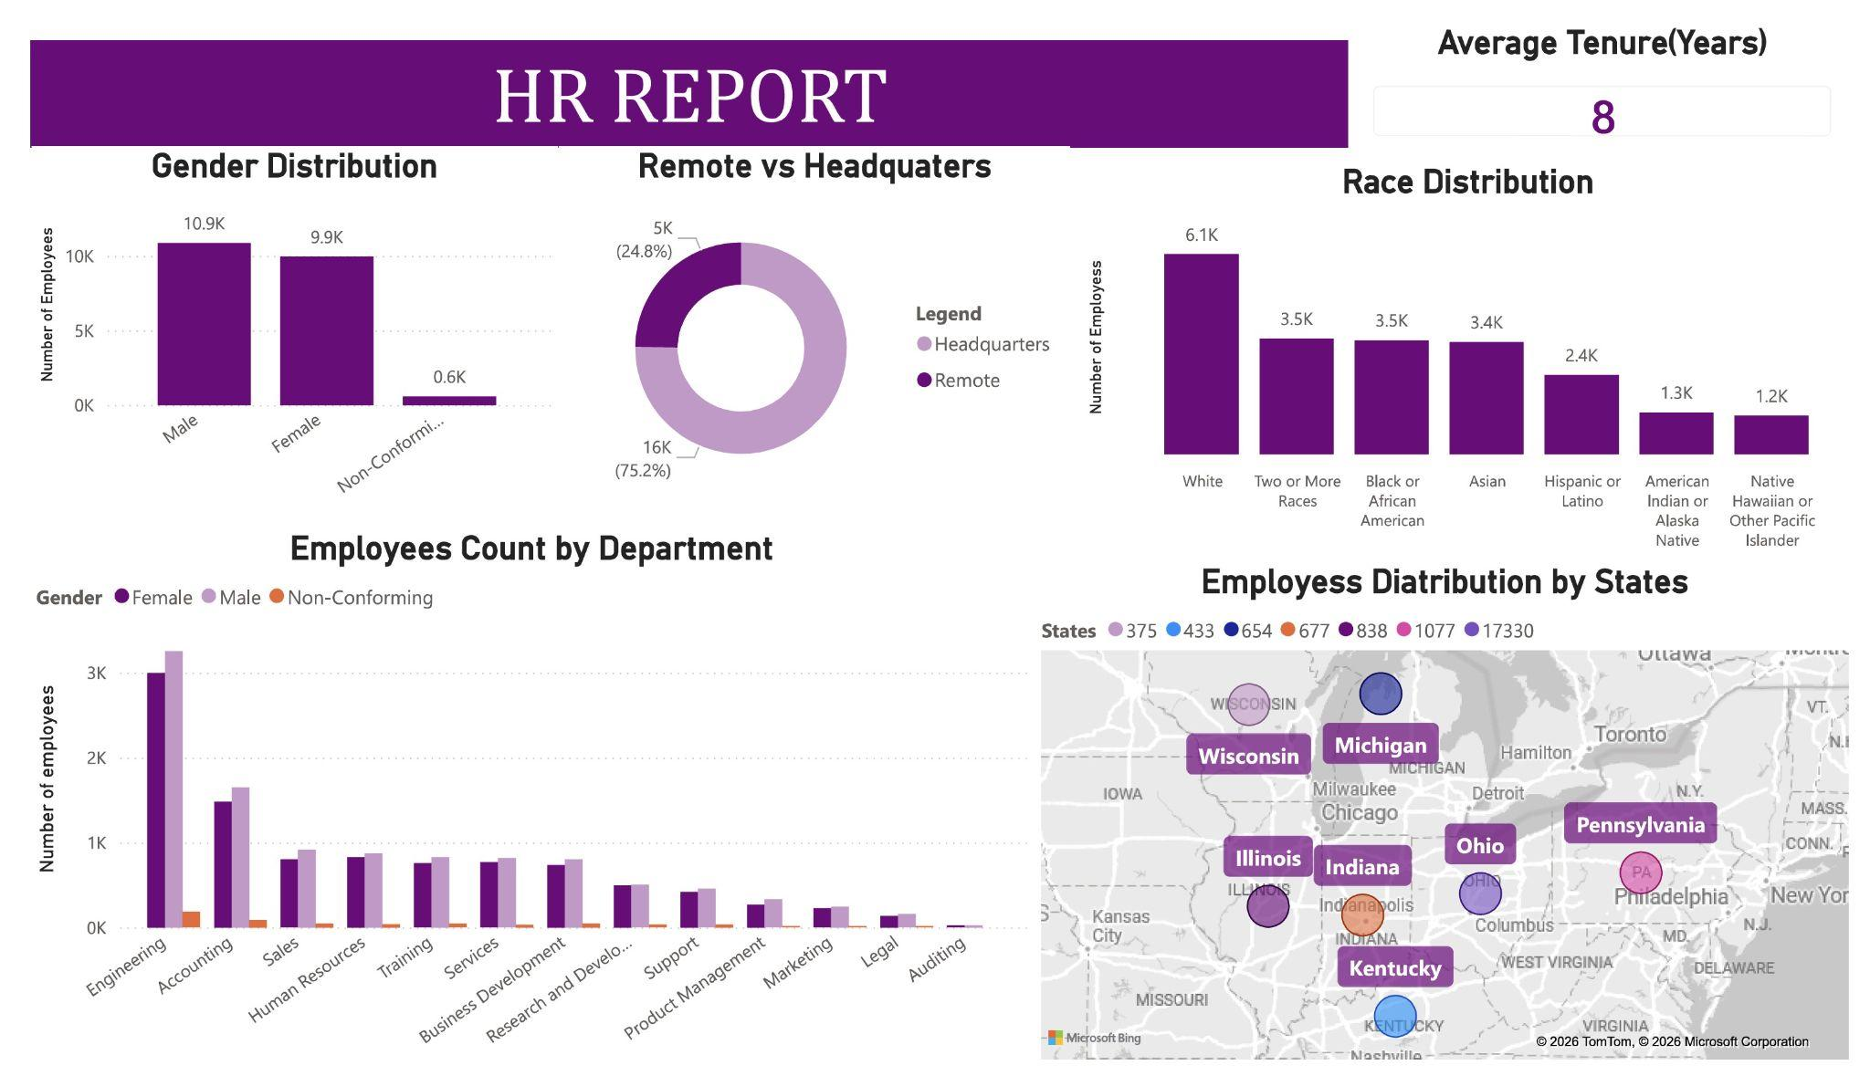
WORKFORCE OVERVIEW

Slide 5
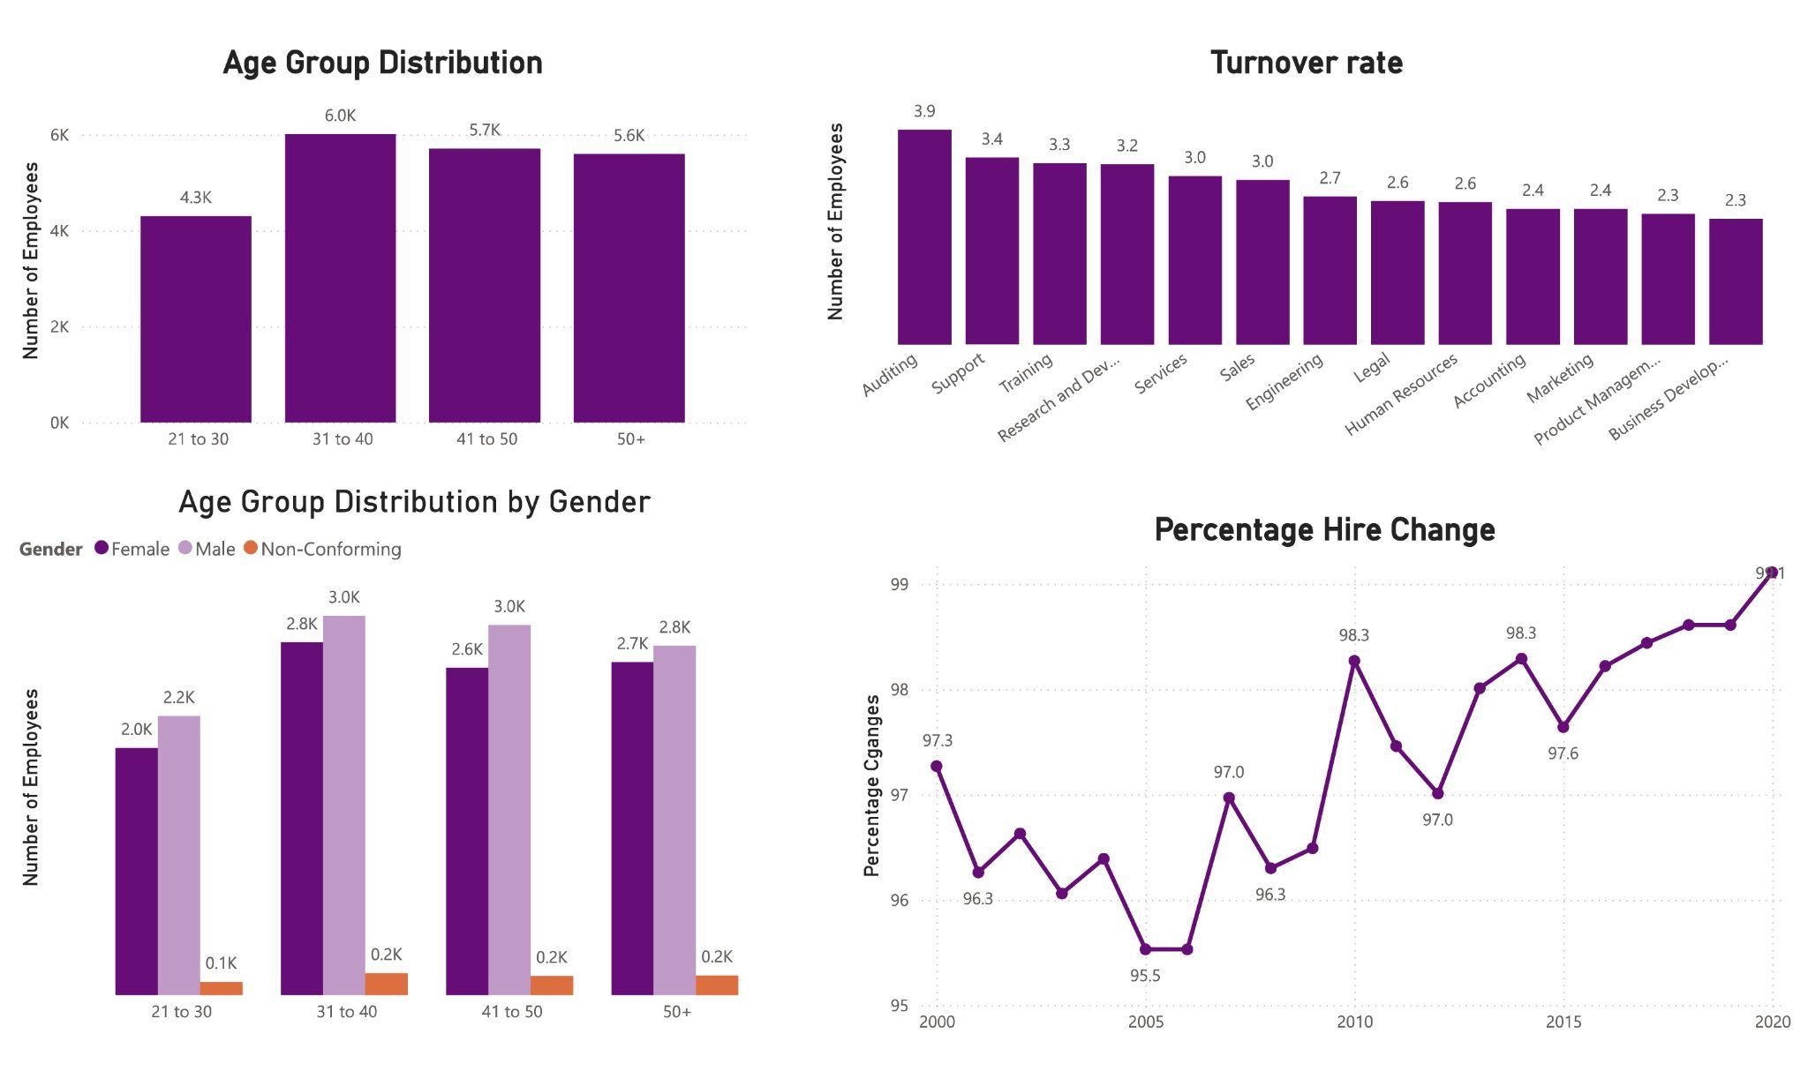
DEMOGRAPHICS

Slide 6

PRESENTATION OUTLINE
1 Introduction to Data Scope: Overview of dataset and objectives.
2 Key Strategic Metrics: Essential performance indicators for HR.
3 Departmental Growth Analysis: Vertical scaling and functional distribution.
4 Diversity & Demographic Insights: Gender and racial representation trends.
5 Recruitment & Retention Trends: Historical growth and future projections.
6 Roadmap & Tool Overview: Analytical stack and next strategic steps.

Slide 7
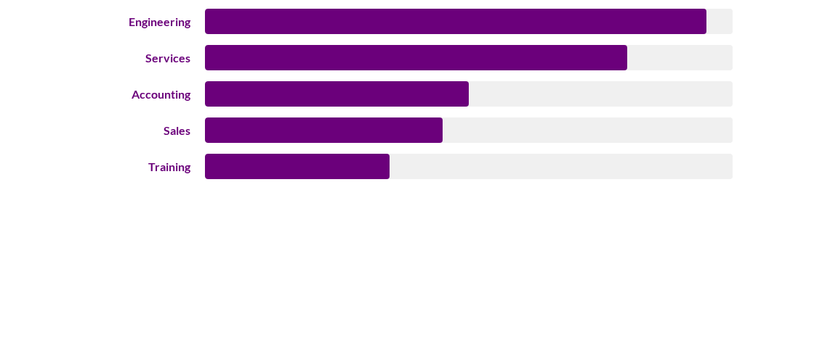

DEPARTMENT COMPARISON
6310
1939
1607
1440
1348
Summary: Engineering remains the largest functional vertical, accounting for nearly 35% of the total workforce. This heavy technical weighting aligns with our position as a product-led organization. Overall, Engineering and Services form the backbone of our workforce volume, representing over 60% of total staff.

Slide 8

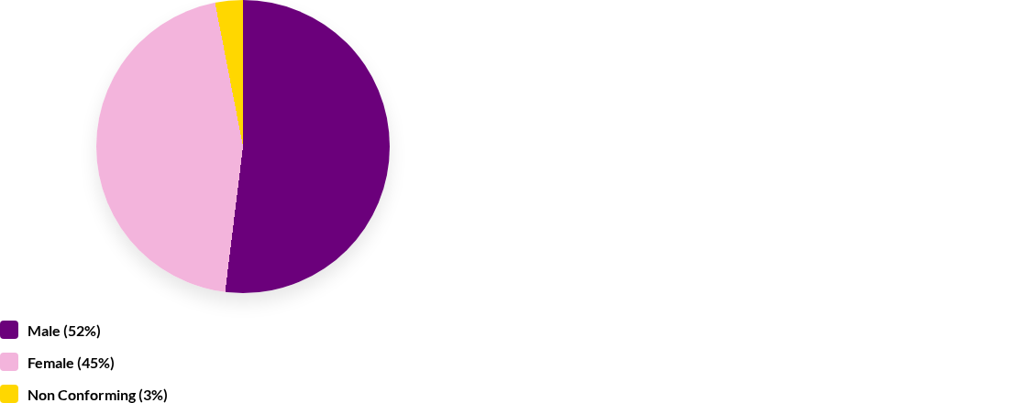
GENDER DIVERSITY BREAKDOWN
Summary: Our organization exhibits a healthy gender balance compared to industry standards. The inclusion of non conforming identities (shown in yellow) reflects our commitment to a diverse environment that welcomes all perspectives. Future efforts should focus on maintaining this ratio in senior leadership.

Slide 9
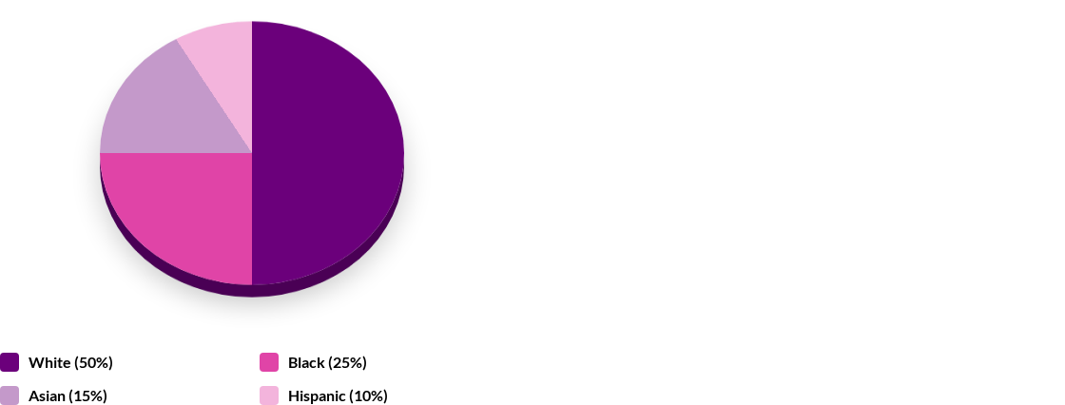

WORKFORCE ETHNIC COMPOSITION
Strategic Summary: Our racial distribution highlights a global mindset with a strong majority of White and Black/African American employees. This diverse base is a key driver for our innovative culture. Utilizing specific 3D analysis helps us visualize our competitive advantage in cultural intelligence while identifying opportunities to increase Asian and Hispanic representation to match market trends.

Slide 10
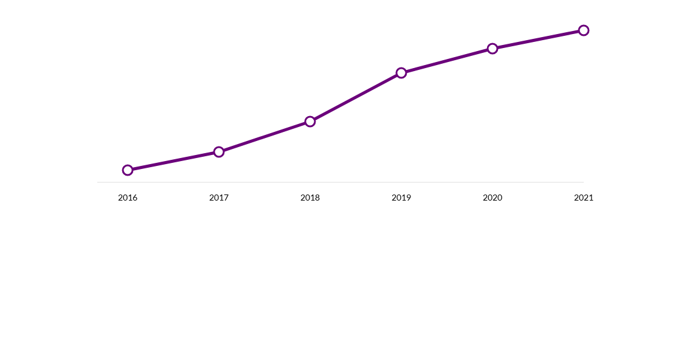

YEAR-ON-YEAR GROWTH TRENDS
Insight Summary: We observed a 40% acceleration in hiring between 2017 and 2021. The upward trajectory indicates a robust hiring pipeline and high market demand. Scaling recruitment infrastructures has successfully transitioned early stability into rapid growth, maintaining high retention across all new cohorts.

Slide 11


CONCLUSION & STRATEGIC PATH
Main Findings
Recommendations
Our Team: Total active workforce consists of 1,000+ staff members, growing consistently year-over-year.
Find new talent in different places (Diversity)
•
Check the "Health" of our team every month (Tracking)
Support our biggest departments (Engineering & Services)
•
Diversity remains a core strength, particularly in functional departments like Legal and HR.
Keep the gender balance steady
•
Engineering is the primary vertical for technical skill sets and product development.
Help experienced workers grow (Mentorship)

Slide 12



TOOLS
Excel
Power BI
SQL
Used for organizing raw data and ensuring accuracy before analysis.
Main tool for creating interactive charts and visual dashboards.
Used to query the database and extract specific data for this report.
Kesha Soni

Slide 13
Thank You!

